Slide 1

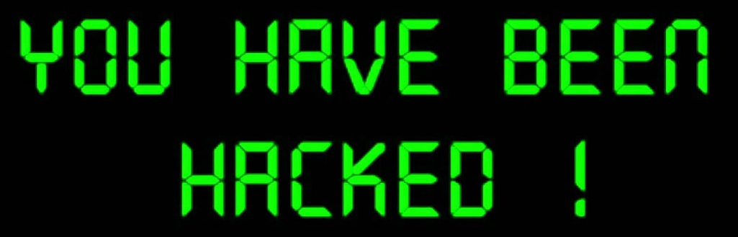
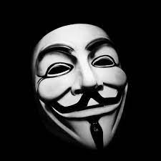
Final Presentation
- Assessment of Team 4 -
Team 3 : 100 % Certified
Notes:
Good morning.
This is Soohyun Yi from Team 3 who will be presenting today.
Let's start the final presentation of team 3.
Our team performed an assessment on the CCTV monitoring system of team 4.
안녕하세요.
오늘 발표를 진행할 3팀의 이수현 입니다.
3팀의 final presentation을 시작하겠습니다.
저희팀에서는 4팀의 CCTV 모니터링 시스템에 대한 Assessment를 수행하였습니다.

Slide 2
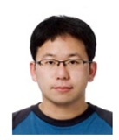
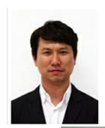
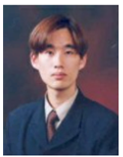
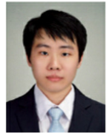

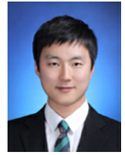
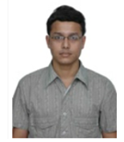

Team 3 - Member Introduction
Name | Kyuwoon Kim | Gyeonghun Ro | Wonyoung Chang | Soohyun Yi | Hyejin Oh | Hyungjin Choi | Vibhanshu Dhote | Cliff Huff
Phase2 Role & Responsibility | Vulnerability analysis, System attack, Information gathering | Project Manager, System Analysis, CC Vulnerability analysis | Vulnerability analysis, System attack, Information gathering | Vulnerability analysis, System attack,Information gathering | Vulnerability analysis, Threat Modeling, Information gathering | Vulnerability analysis, System attack, Information gathering | Vulnerability analysis, System attack, Information gathering | Mentor
LGE Email | kyuwoon.kim@lge.com | gyeonghun.ro@lge.com | wonyoung.jang@lge.com | soohyun.yi@lge.com | hyejin.oh@lge.com | jin0925.choi@lge.com | vibhanshu.dhote@lge.com
Personal Email (CMU account) | mnik83@gmail.com | gyeonghun.ro@gmail.com | wonyoungjjang@gmail.com | randelx@gmail.com | chaolly007@gmail.com | zzzzdx@gmail.com | dhotevibhanshu@gmail.com | cch@sei.cmu.edu
Alias Email of Team 3 : cmu-team3@lge.com
1
Notes:
Introducing our team members.
Team 3 consists of a total of 7 members, 6 in Korea and 1 in India.
Our mentor is Cliff, and he helped us a lot in the progress of the project.
우리팀 멤버를 소개합니다.
총 7명의 멤버로 구성되어 있으며, 6명은 한국에, 1명은 인디아에 있습니다.
멘토는 cliff이며 프로젝트 진행에 많은 도움을 주셨습니다.

Slide 3
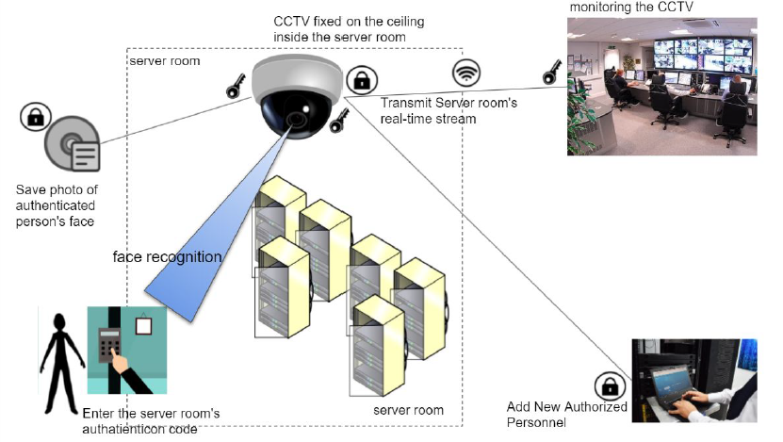
Monitoring System Overview
2
Notes:
The monitoring system is designed for security in the server room.
The CCTV installed in the server room detects people entering and exiting, and the screen is monitored through the Security Agent.
The CCTV administrator performs user registration and deletion for the person entering the server room.
모니터링 시스템은 server room에 대한 보안을 위해 설계되었습니다.
Server room에 설치된 CCTV에서 출입하는 인원에 대한 감지를 수행하고, 해당 화면이 Security Agent를 통해 모니터링 됩니다.
CCTV 관리자는 server room에 출입하는 인원에 대한 사용자 등록 및 삭제를 수행합니다.

Slide 4

Monitoring System Overview
Monitoring System
Demo
3
Notes:
Let's watch a video to understand the monitoring system easily.
모니터링 시스템을 쉽게 이해하기 위한 동영상을 시청하겠습니다.

Slide 5





Assessment Process
Before proceeding with the assessment of the output for Team 4, determine the assessment process as follows.
Proceed to explain the output that came out according to the process
Information
gathering
Threat
Modeling
Vulnerability
Analysis
System Attack
Assessment based on International standard
4
Notes:
A plan was drawn up to evaluate the project of the team 4, and a process was drawn up as shown on the screen.
4팀의 프로젝트를 평가하기 위한 계획을 세웠고, 화면에 보이는 것과 같은 프로세스를 도출하였습니다.

Slide 6


System Analysis - Context diagram
Person
CCTV
Monitoring System
CCTV
Monitoring System
Admin
Security Agent
legend
System
App
camera
user
Network
Connection
5
Notes:
First, a context diagram for information gathering was derived.
You can check each component of the monitoring system.
먼저 information gathering을 위한 context diagram을 도출하였습니다.
모니터링 시스템의 각 구성요소들을 확인할 수 있습니다.

Slide 7

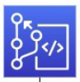

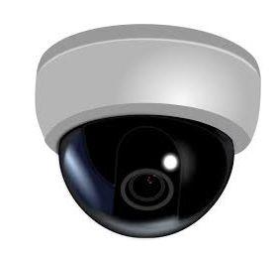


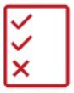
System Analysis - Activities
Open Source Known Vulnerabilities Identification
Design/Code Review
Vulnerability Scanner
Nessus
Static Analysis
Fuzz Testing
RATS/ SonarCloud/Code X-ray
zzuf, AFL
Security Focused Testing
6
Notes:
We used the methods and tools shown in the slides for system vulnerability analysis.
A vulnerability scanner, fuzz testing tools, and a static analyzer were used.
시스템에 대한 취약점 분석을 위해 슬라이드에 보이는 method와 툴을 사용했습니다.
vulnerability scanner, fuzz testing tools, static analyer가 사용되었습니다.

Slide 8



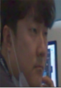

Threat Analysis with PnG
PnG1 : Mark
PnG2 :Tom
PnG3 :John
One of security agents who
works in three shifts
Employee who plans to move to rival company
Employee who would like to make his co-worker project go into trouble
PnG Description
To gain money for overlooking the unauthorized access
To disrupt IT infrastructure during crucial hours
Motivation
To sell project data
Knowledge of “manager” password
Knowledge that there is no user authentication mechanism in the system
Knowledge in hacking techniques and tools
Knowledge of image recognition mechanism.
Skills
1) Login with common “manager” account
2) Add new (unauthorized) users to the system
3) When the new users enter server room, no alarm rings.
4) Delete the users from the system, no one knows he does the mis-behavior.
1) Brute force attack with login cracking tool and obtain “manager” credentials.
2) Login with “manager” account and
change his picture with the authorized
person’s picture
3) When he enters server room, no alarm.
1) Take the picture of authorized
person and make mask with it.
2) Put the mask when entering Server room, no Alarm.
Misuse Cases
7
Notes:
Three personas were derived using PnG for Threats Analysis.
Through each misuse case, we were able to specify the security vulnerabilities of the current system in detail.
Threats Analysis를 위해 PnG를 사용하여 3개의 페르소나를 도출했습니다.
각각의 misuse cases들을 통해 현 시스템의 보안상 취약점을 자세하게 명세할 수 있었습니다.

Slide 9
Context diagram with initial vulnerability check
Person
CCTV
Monitoring System
CCTV
Monitoring System
Admin
Security Agent
legend
Severity
High
Severity
Medium
Severity
Low
System
App
camera
user
Network
Connection
8
Notes:
This is a diagram showing the notation of vulnerabilities in the system according to the degree of risk.
You can check the distribution of vulnerabilities according to the level of risk in each entity.
시스템에서 취약점에 대한 표기를 위험도에 따라 표시한 다이어그램입니다.
각 entity에서 위험도에 따른 취약점 분포를 확인할 수 있습니다.

Slide 10



System Design Analysis with Dynamic View
non-repudiation
Test Video
Log storage
Camera Device
image
log
log
captured data
Person
Monitoring system
image/result
CCTV
Key Manager
start monitor
key
image/result
connection request
Security Agent
key
Confidentiality
Confidentiality, Availability
user image
user image
User register
Image Storage
command
Monitoring System
CCTV
image
to register
command result
Admin
legend
thread
storage
external
device
data
flow
cert
Secure key
9
Notes:
This is a DFD that shows the monitoring system with a little more decomposition.
From this, we determined that the red square would have a security target for the system.
모니터링 시스템을 좀 더 decomposition하여 나타낸 DFD 입니다.
이를 통하여 우리는 붉은 색 사각형에 시스템의 보안 목표가 있을 것으로 판단했습니다.

Slide 11
Monitoring System with Vulnerability
Test Video
Log storage
Camera Device
image
log
log
captured data
Person
Monitoring system
image/result
CCTV
Key Manager
start monitor
key
image/result
connection request
Security Agent
key
user image
user image
User register
Image Storage
command
Monitoring System
CCTV
image
to register
command result
Admin
legend
Severity
High
Severity
Medium
Severity
Low
thread
storage
external
device
data
flow
cert
Secure key
10
Notes:
As a result of analyzing the actual vulnerabilities, they were distributed in various points according to their severity.
On the next page, we will explain the results of our analysis with a focus on High severity.
실제 취약점을 분석해 본 결과, 그것들은 심각도에 따라 여러 지점에 분포되어 있었습니다.
High 심각도에 대한 내용을 중심으로 분석한 결과에 대해 다음 페이지에서 설명하겠습니다.

Slide 12
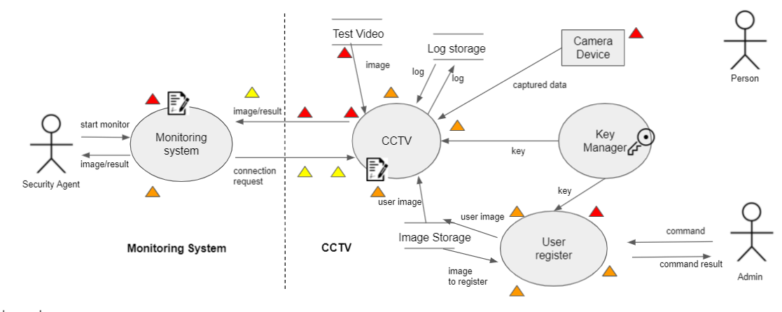
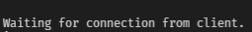
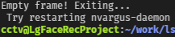
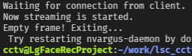
Vulnerability analysis - CCTV
Vulnerability High : CCTV
1. Recorded Play (TEST RUN):
There is no recorded play in the requirements document.
But if you manually run CCTV with recorded playback file name, you can run it with recorded playback.
When all recorded videos are played, the connection is disconnected and the service is stopped.
If the recorded video is incorrect, the connection will be disconnected and the service will be stopped.
Test Video
1.normal video file
Service stopped
2.normal video file, all played
Monitoring system
image/result
CCTV
start monitor
3.incorrect video file
image/result
connection request
Security Agent
11
Notes:
The current page shows the vulnerabilities for CCTV.
There is no mention of video file playback in the document provided by the team 4, but we confirmed that playback is possible through actual CCTV command input.
When a normal video file is finished playing or an abnormal video file is played, the connection is terminated.
As a result, the service is stopped, violating availability.
현재 페이지는 CCTV에 대한 취약점을 보여줍니다.
4팀에서 제공받은 document에는 비디오 파일 재생의 언급이 없지만, 실제 CCTV의 커맨드 입력을 통해 재생이 가능함을 확인했습니다.
정상적인 비디오 파일이 재생 완료되거나, 비정상적인 비디오 파일을 재생 시 connection이 종료됩니다.
그 결과 서비스가 중지되어 availability를 위배하게 됩니다.

Slide 13



Vulnerability analysis - CCTV
Vulnerability High : CCTV
Need to provide
2. Unable to verify as a video file :
There is a log file, so you can check who entered when, but you can't check it because the video is not saved.
Need to provide
3. Video file encryption required :
Encryption is required for video files that can be hijacked when intrusion into the monitoring system from outside.
12
Notes:
Another vulnerability of CCTV.
For one thing, you can check whether you have entered or not through the log, but there is no video record, so you cannot check the actual face.
Another is that since CCTV has a video playback function, the video file existing in the system must be encrypted to prevent exposure of personal information, but that function is also missing.
또다른 CCTV의 취약점 입니다.
한 가지는 로그를 통해 출입 여부를 알 수는 있으나, 비디오 기록이 없어 실제 얼굴에 대한 확인이 불가합니다.
또 다른 하나는 CCTV에서 비디오 재생 기능이 있기 때문에, 시스템에 존재하는 비디오파일은 암호화가 되어 있어야 개인정보의 노출이 방지되나 해당 기능 또한 누락되어 있습니다.

Slide 14


Vulnerability analysis - Monitoring system
Vulnerability High : Monitoring system
Need to provide
1. No user authentication :
There is no authentication procedure for security agent, so there is a possibility of exposure of CCTV information.
2. Unable to check whether it is a live video or a recorded video :
There is no icon to indicate when CCTV is shown live or when it shows recorded video, so it is impossible to distinguish between them.
Currently, we can check the video is recorded when 'friends' is played.
Need to provide
13
Notes:
The following is an analysis of the monitoring system.
Since the monitoring system does not have a user authentication procedure, there is a problem that even an unauthorized person can view the CCTV screen.
Also, there is a problem that it is impossible to distinguish whether the output video stream is a live video or not.
다음은 monitoring system에 대한 분석입니다.
monitoring system은 user authentication 절차가 없기 때문에, 인가되지 않은 사람도 CCTV의 화면을 열람할 수 있는 문제가 있습니다.
그리고, 출력되는 비디오 스트림이 라이브 영상인지 아닌지 구별할 수 없는 문제도 존재합니다.

Slide 15
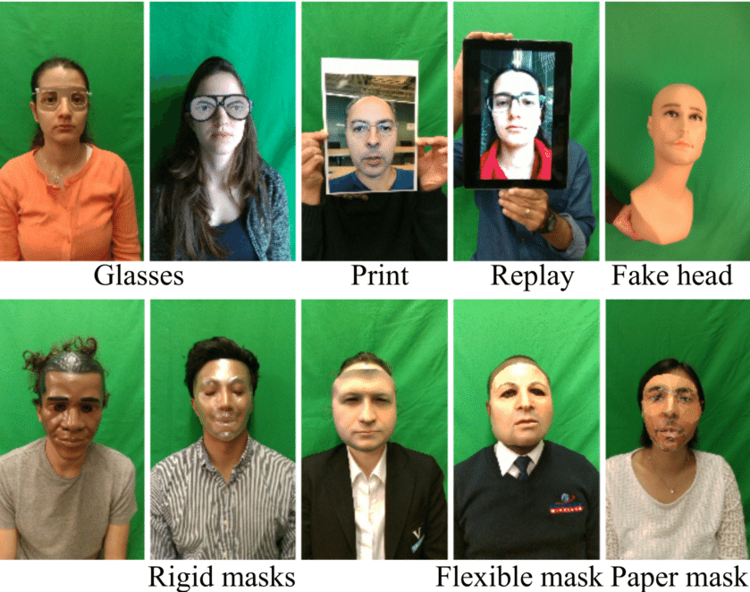
Vulnerability analysis - Camera
Vulnerability High : Camera
Fake face :
When the security agent goes to the bathroom for a while,there are no countermeasures against the fake face.
14
Notes:
A vulnerability was also found in Camera.
It can be assumed that various types of fake faces are exposed to the camera, such as the picture shown on the screen.
In this case, there is a problem that the camera recognizes it as a real person in the absence of the Security Agent.
Camera에서도 취약점이 발견되었습니다.
화면에 보이는 사진과 같이 다양한 형태의 fake face를 카메라에 노출할 경우를 가정할 수 있는데,
이 경우, Security Agent의 부재 시 카메라가 이를 실제 사람으로 인식하는 문제점이 있습니다.

Slide 16
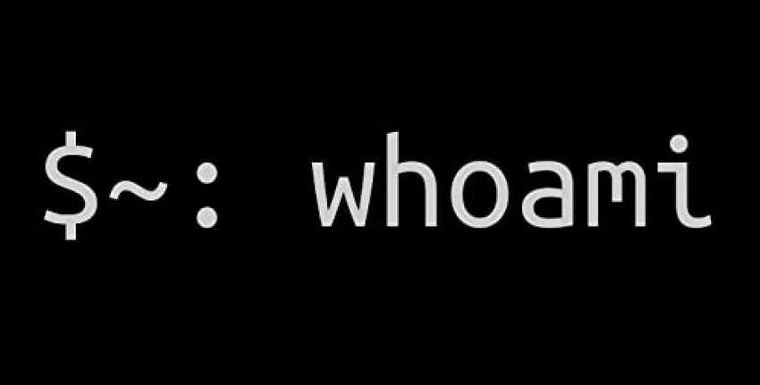
Vulnerability analysis - User register
Vulnerability High : User register
Admin account hijacking :
There is no password guide for account creation, so if an account is created with an easy password, the admin account may be hijacked.
- If the admin account is exposed, follow-up actions such as user registration become possible.
15
Notes:
In the case of user register, there is no guide for password setting when creating an admin account in the current system.
Therefore, it is possible to set a weak password depending on the account creator, and in this case, there may be a vulnerability that the admin account can be hijacked.
User register의 경우, 현 시스템에서는 admin 계정 생성시 패스워드 설정에 대한 가이드가 없습니다.
따라서 계정 생성자에 따라 취약한 패스워드 설정이 가능하고, 이러한 경우 admin 계정이 탈취될 수 있는 취약점이 존재할 수 있습니다.

Slide 17
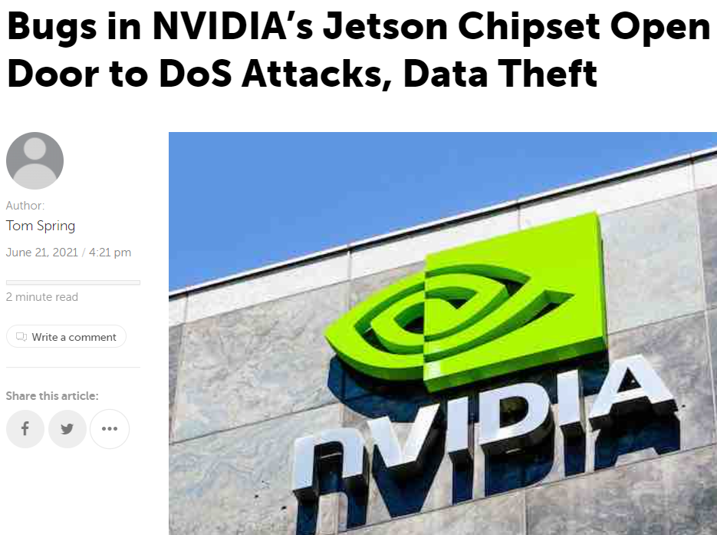

Vulnerability analysis - Common
Vulnerability High : Common
34 open source known vulnerabilities identified by the analysis of Team 3.
The remaining known vulnerabilities can be exploited by attackers.
To apply the latest security updates is recommended.
No. | OSS Name / Version | CVE ID | Severity | NVD Score | Description
1 | OpenSSL v1.1.1 | CVE-2021-23840 | High | 7.5 | Calls to EVP_CipherUpdate, EVP_EncryptUpdate and EVP_DecryptUpdate may overflow the output length argument in some cases where the input length is close t ...
...
3 | OpenCV 4.1.1 | CVE-2019-5064 | High | 8.8 | An exploitable heap buffer overflow vulnerability exists in the data structure persistence functionality of OpenCV, before version 4.2.0. A specially crafted ...
...
9 | Jetson Linux 32.5 | CVE‑2021‑34372 | - | 8.2 | Trusty (the trusted OS produced by NVIDIA for Jetson devices) driver contains a vulnerability in the NVIDIA OTE protocol message parsing code where an integer ...
16
Notes:
We were able to identify vulnerabilities in open source as well.
The results of our review on OpenSSL, OpenCV and Jetson Linux are on the slides.
Open source에 대한 취약점도 파악할 수 있었습니다.
OpenSSL과 OpenCV, Jetson Linux에서의 검토 결과가 슬라이드에 있습니다.

Slide 18

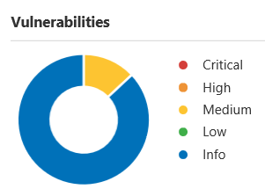
Vulnerability analysis - Common
Vulnerability Medium : Common
3
Three vulnerabilities detected by vulnerability scanner, Nessus.
The following vulnerabilities themself are not meaningful because of the project constraints.
Can be the useful information later for the attack vector analysis.
24
No. | Name | Severity | Description | Solution
1 | Microsoft Windows Remote Desktop Protocol Server Man-in-the-Middle Weakness | Medium | This flaw exists because the RDP server stores a hard-coded RSA private key in the mstlsapi.dll library. Any local user with access to this file (on any Windows system) can retrieve the key and use it for this attack. | - Force the use of SSL as a transport layer for this service if supported, or/and - Select the 'Allow connections only from computers running Remote Desktop with Network Level Authentication' setting if it is available.
2 | SSL Self-Signed Certificate | Medium | The X.509 certificate chain for this service is not signed by a recognized certificate authority. | Purchase or generate a proper SSL certificate for this service
3 | SSL Certificate Cannot Be Trusted | Medium | The top of the certificate chain sent by the server might not be descended from a known public certificate authority. | Purchase or generate a proper SSL certificate for this service.
17
Notes:
This is the result of performing a vulnerability scan using the Nessus tool.
Some meaningless contents were derived due to project constraints, but these parts can be used for attack vector analysis.
Nessus 툴을 사용하여 취약점 스캔을 수행한 결과입니다.
프로젝트의 constraints 때문에 일부 의미가 없는 내용들이 도출되었으나, 이러한 부분들은 attack vector 분석에 사용될 수 있습니다.

Slide 19
Vulnerability analysis - Common
Vulnerability High : Common
Static analysis : Secure coding
Tools | Total Detected | High | Medium | Low | Remark
RATs | 41 | 11 | 12 | 18 | Defects related to secure code were found, but there were no serious contents ※ 7 defects exist in the initial code of the project
SonarCloud | 383 | 2 | 136 | 245 | 2 high defects are worth analyzing. 383 defects are detected as a code smell type.
Code x-ray | 24 | 1 | 4 | 19 | A high defect is unused code, and medium defects are open source code smell.
Vulnerability #1
File Path |  | Contents |  | Line | Link
MonitoringSystem/ SslConnect.cpp |  | Enable server hostname verification on this SSL/TLS connection |  | 52 | https://sonarcloud.io/project/issues?id=chj1986_lsc_cctv&open=AXo7pUX0xwP7BFHx5ihC&resolved=false&types=VULNERABILITY
Vulnerability #2
File Path |  | Contents |  | Line | Link
CCTV/FakeCCTV.cpp |  | Printf-style format strings should not lead to unexpected behavior at runtime |  | 112 | https://sonarcloud.io/code?id=chj1986_lsc_cctv&selected=chj1986_lsc_cctv%3ACCTV%2FFakeCCTV.cpp&line=112
18
Notes:
The results of static analysis through the tools are as follows.
Three tools were used: RATs, SonarCloud, and Code x-ray, and defects with high severity were detected through SonarCloud and Code x-ray.
툴들을 통해 Static analysis를 수행한 결과는 다음과 같습니다.
RATs, SonarCloud, Code x-ray 세 가지의 툴을 사용하였고, SonarCloud와 Code x-ray를 통해 심각도가 높은 defect가 검출되었습니다.

Slide 20
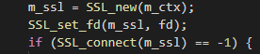
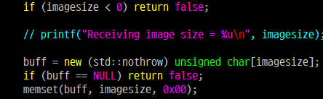
Vulnerability analysis - Common
Vulnerability High : Common
Secure coding : Static analysis
⬛ Vulnerability from static analysis result
1) Enable server hostname verification on this SSL/TLS connection
Client did not verify Server’s certificate, it could be mutual anonymous ciphers are not allowed
2) Compares unsigned int is negative, Allow up to 4GB image file, memset argument confusing
Comparison statements and memset have no effect, and unusually large image files cause assert in opencv
Unverified Server’s certificate
19
Notes:
It is a vulnerability derived from static analysis through code review.
It has been confirmed that the client is using the server's certificate without validating it.
It was also found that checking for negative numbers for unsigned integer type variables, or entering the parameters of memset incorrectly.
코드 리뷰를 통한 Static analysis로 도출된 취약점입니다.
Client에서 server의 certificate를 검증하지 않고 이를 사용하고 있는 것이 확인되었습니다.
unsigned integer 타입 변수에 대해 음수를 확인 하거나, memset의 매개변수를 잘못 입력하는 점도 발견되었습니다.

Slide 21
Monitoring System with attack vector
Test Video
Log storage
Camera Device
image
attack vector-2
log
log
Person
attack vector-3
captured data
Monitoring system
image/result
CCTV
Key Manager
start monitor
key
image/result
connection request
Security Agent
key
user image
attack vector-1
user image
User register
Image Storage
command
Monitoring System
CCTV
image
to register
command result
Admin
legend
thread
storage
external
device
data
flow
cert
Secure key
Hacker
attack
20
Notes:
This is a diagram that derives the attack vector for the monitoring system based on the vulnerability analysis so far.
There are three attack vectors in total, and I will explain each of them on the next page.
지금까지의 취약점 분석을 기반으로 Monitoring system에 대한 attack vector를 도출한 다이어그램입니다.
총 3개의 attack vector로 구분되며 다음 페이지에서 각 항목에 대한 설명을 드리겠습니다.

Slide 22
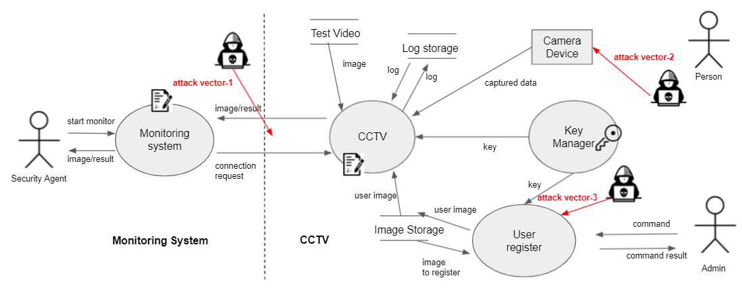

System Attack - User Register
Attack Vector-1 : User Register
Brute-force attack:
To register user, ssh service is used and port is opened.
There is no password guide for account creation, so an account could be created with an easy password.
No brute-force login blocking.
Unlocked after 1053 attempts with default username and password. (lg / lg, has sudo privileges)
Unlocked after 32920 attempts with simple password. (cctv / cctv, tried only lowercase letters)
Get a account
21
Notes:
This is the result of performing a brute force attack to figure out the password using the hydra tool in the User Register.
Each account was configured with an easy password, as there was no guide on setting up a password.
As a result, the password was obtained after 1,053 attempts for the LG account.
Subsequently, the cctv account was also able to steal the password after about 33,000 attempts.
User Register에서 hydra tool을 사용하여 password 파악을 위해 brute force attack을 수행한 결과입니다.
패스워드 설정에 대한 가이드가 없었기 때문에 각 계정은 쉬운 패스워드로 구성되어 있습니다.
그 결과 lg계정에 대하여 1,053번의 시도 후 패스워드를 획득할 수 있었습니다.
이어서 cctv계정 또한 약 33,000번의 시도 후 패스워드 탈취가 가능했습니다.

Slide 23


System Attack - User Register
Attack Vector-1 : User Register
User registration process
1. Enter the photo name and the user name to be registered for user registration.
- command : ./UserRegister add Mike.jpg Mike
2. The picture corresponding to the user name is encrypted and stored in the /imgs folder.
Various attacks can be considered in this registration process.
./UserRegister add
Mike
Mike.jpg
22
Notes:
In User Registration, the user's image file and name are passed as input values.
This allows the actual attack to be carried out via image files and name strings.
User Registration에서는 입력 값으로 사용자의 이미지 파일과 이름이 전달됩니다.
이에 따라 이미지 파일과 이름 스트링을 통해 실제 공격이 수행될 수 있습니다.

Slide 24

System Attack - User Register
Attack Vector-1 : User Register
User Register Attack : Spoofing
UserRegister
encrypt_filename
make
Encoded
F6nBrnBFBClnQub3EXoO9Q==
Image
Changed
make
Person
ImagePath
No Input
Validation
main
do_crypt
_file
Mike
(Actually John)
add
Authorized
Mike
Mike
F6nBrnBFBClnQub3EXoO9Q==
F6nBrnBFBClnQub3EXoO9Q==
23
Notes:
This is an example showing that spoofing is possible by using the vulnerability of the user register.
With Mike already registered in the database, John uses his image file to register one more time with Mike's name.
At this time, since there is no duplicate check for names already registered in the system, the registered images are replaced.
As a result, John can enter the server room pretending to be Mike.
User Register의 취약점을 이용하여 Spoofing이 가능함을 보여주는 예시입니다.
이미 데이터베이스에 Mike가 등록된 상태에서 John이 자신의 이미지파일을 사용하여 Mike의 이름으로 한번 더 등록합니다.
이때 시스템 내부에서 이미 등록된 이름에 대한 중복 체크가 없기 때문에, 등록된 이미지가 교체됩니다.
그 결과 John은 Mike인척 서버룸에 출입할 수 있습니다.

Slide 25
System Attack - User Register
Attack Vector-1 : User Register
User Register Attack : Stack Smashing
UserRegister
make
Encoded
No Input
Validation
encrypt_filename
OpenSSL
make
Person
ImagePath
aaaaaaaaaaaaaaaaaaaaaaaaaaaaaaaaaaaaaaaaaaaaaaaaaaaaaa
main
EVP_CipherUpdate
add
Authorized
Stack
Smashing
24
Notes:
User Register receives the user's name when registering or deleting a user.
At this time, if you input a very long string, stack smashing occurs while the string is passed to OpenSSL and processed.
This is a case where the program terminates because the length of the input string is not checked.
User Register는 사용자 등록 및 삭제 시 사용자의 이름을 입력받습니다.
이 때 굉장히 긴 문자열을 입력하게 되면 해당 스트링이 OpenSSL로 전달되어 처리되는 과정에서 Stack Smashing이 발생합니다.
입력받는 스트링의 길이를 체크하지 않아 프로그램이 종료되는 케이스입니다.

Slide 26

System Attack - User Register
Attack Vector-1 : User Register
User Register Attack : Assertion Failed with the exception from Fuzz
UserRegister
No Exception
Handler
OpenCV
main
Assertion Failed
loadInput
Image
add
Authorized
Fuzz
resize
25
Notes:
This is an attack using an image file that is input when registering a user.
Using ZUFF, we created 10000 malformed image files and used them as input parameters.
In this case, an Assertion Failed occurred in OpenCV when inputting an image file with a corrupt header.
However, there is no syntax to catch this in the main function, so abnormal termination occurs. This part needs exception handling.
사용자 등록시 입력받는 이미지 파일을 사용한 공격입니다.
ZUFF를 사용하여 10000장의 변형된 이미지 파일들을 생성했고, 이를 입력 인자로 사용했습니다.
이 경우, 헤더가 손상된 이미지 파일 입력 시 OpenCV에서 Assertion Failed이 발생했습니다.
그런데 main 함수에서 이를 catch하는 구문이 없어 abnormal termination이 발생합니다.
이 부분은 exception handling이 필요합니다.

Slide 27
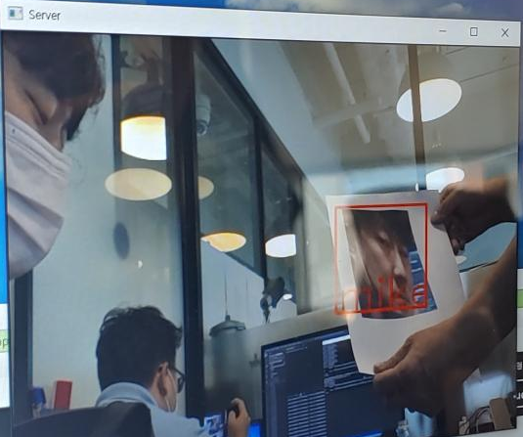
System Attack - Camera
Attack Vector-2 : Camera
fake face authentication
Fake Face Attack :
In order to disturb the monitoring system that is authenticated through the face, the reaction of the system was confirmed through the photo of the authenticated face.
It did not recognize it as a photo, but recognized it as a face and displayed the name.
26
Notes:
The next attack vector is the camera.
CCTV also recognizes an image of a person printed on paper as a real person.
If there is no judgment of the Security Agent, there is a vulnerability to attack through the printed fake face.
다음 attack vector는 camera 입니다.
CCTV는 종이에 인쇄된 한 사람의 이미지도 실제 사람으로 인식하고 있습니다.
Security Agent의 판단이 없을 경우, 인쇄된 fake face를 통한 공격에 대한 취약점이 존재합니다.

Slide 28

System Attack - mutual authentication
Attack Vector-3 : mutual authentication
Since the verification of the RootCA certificate is not performed, mutual authentication is performed even if the Team 3 certificate is used.
Replace with team 3 certificate
Monitoring system
CCTV
Team 3’s Cert
Team 3’s Cert
malicious rootCA
rootCA
rootCA
malicious rootCA
malicious client
client
Server
malicious Server
malicious client
client
Server
malicious Server
27
Notes:
The next attack vector is about mutual authentication.
Currently, the system does not verify the RootCA.
Because of this, we were able to confirm that mutual authentication was performed through our team's RootCA, not Team 4's.
Since mutual authentication can be performed with any rootCA, there is a vulnerability that enables system operation by unauthorized users.
다음 attack vector는 상호 인증에 대한 내용입니다.
현재 시스템에서는 RootCA에 대한 검증을 수행하지 않고 있습니다.
이로 인하여 Team 4의 것이 아닌 우리 팀의 RootCA를 통해서도 상호인증이 수행됨을 확인할 수 있었습니다.
어떠한 rootCA로도 상호인증을 수행할 수 있으므로 비인가 사용자에 의한 시스템 운용이 가능해지는 취약점이 존재합니다.

Slide 29
System Attack Demonstration
System Attack
Demo
28
Notes:
Let's see the actual attack scene through the video.
영상을 통해 실제 공격 장면을 보겠습니다.

Slide 30

Consideration - Assessment ruler ?
29
Notes:
So far, we have conducted vulnerability analysis and performed exploits based on it.
However, it was difficult to accurately assess with these contents alone.
Therefore, we decided that a standard for making a clear assessment was necessary.
지금까지 취약점 분석을 진행하고 그에 기반한 exploit을 수행했습니다.
그런데 이러한 내용들만 가지고는 정확하게 assessment 하기 어려웠습니다.
따라서 명확한 assessment를 하기 위한 기준이 필요하다고 판단했습니다.

Slide 31

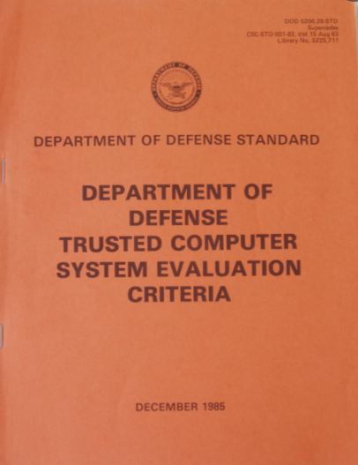

Comparison of assessment methods
We reviewed the assessment methods and selected the assessment method to use.
V
Method | TCSEC (Trusted Computer Security Evaluation Criteria) | ITSEC (Information Technology Security Evaluation Criteria) | CC (Common Criteria)
Description | - Evaluate independent systems, called the orange-book. - It is the first systematic and logical standard that evaluates functionality and assurance without distinction. - Intrinsically too restrictive | - European guidelines for evaluating operating systems and devices - Addressing confidentiality, integrity, and availability - Evaluate functionality and warranty separately - Adds considerable confusion by being overly flexible. | - It is a certification model that integrates TCSEC and ITSEC information security system certification. - CCRA(Common Criteria Recognition Arrangement) is the mutual recognition of accreditation results in agreements among 25 Member nations
30
Notes:
We searched for three methods to review the criteria for assessment.
TCSEC was the first standard, also called the Orange Book.
After that, ITSEC was formed mainly in Europe and is now integrated into Common Criteria.
assessment를 위한 기준을 검토하기 위해 3가지의 methods를 검색했습니다.
TCSEC는 최초의 standard 이며, 오렌지북으로도 불리었습니다.
이 후 유럽 중심으로 ITSEC이 생겼고 현재는 Common Criteria로 통합되었습니다.

Slide 32
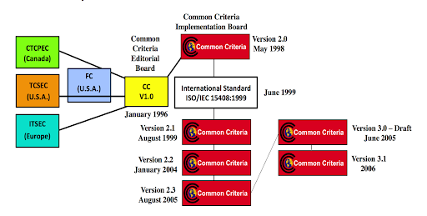
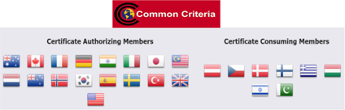
Common Criteria Overview
(CCRA) CCRA(Common Criteria Recognition Arrangement) is the mutual recognition of accreditation results in agreements among 25 Member nations including, US, UK, Germany, and Rep. Of Korea
(Purpose) In order to mutually recognize security assessment among member states, apply the single assessment criteria (CC) and Evaluation Methodology to evaluation Accreditation work
31
Notes:
Since CC is a mutual agreement, it has the advantage that certification obtained in one country is used in many countries.
For this reason, Common Criteria has been selected as the assessment method for evaluating Team 4.
CC는 상호협약이 되어 있어서 한 국가에서 받은 인증이 여러나라에서 통용되는 장점이 있습니다.
이러한 이유로 Common Criteria를 Team 4를 평가하기 위한 assessment method로 선정 하였습니다.

Slide 33
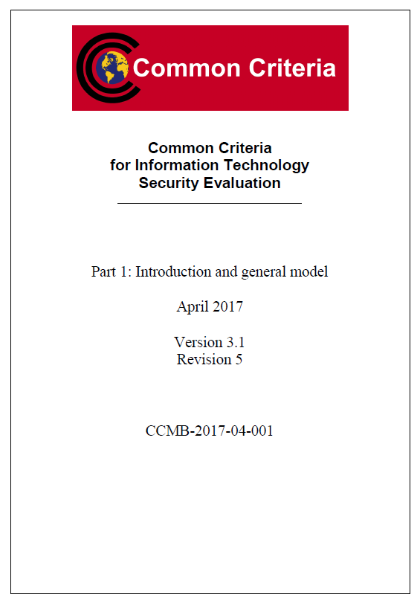
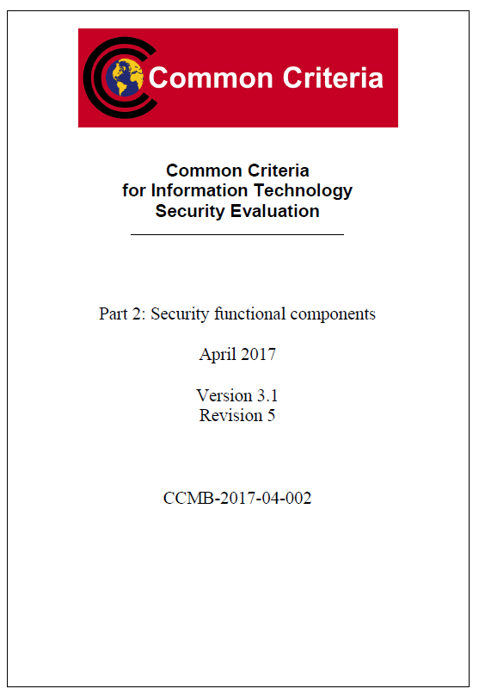
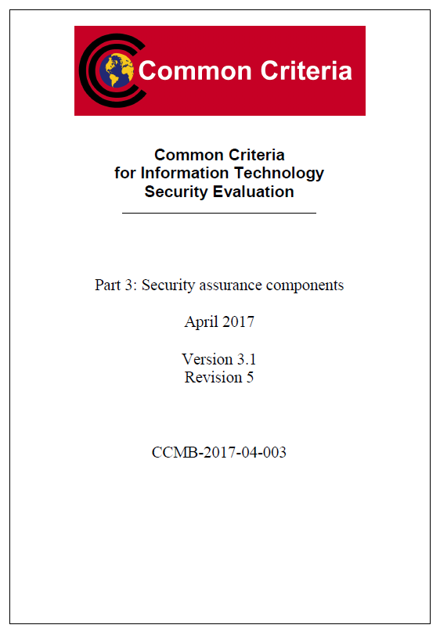
Common Criteria Overview - 3 Part
32
Notes:
Currently, the latest version of CC is 3.1, and it consists of a total of 3 parts.
Part 2 and Part 3 are the main parts that will be used for the actual assessment.
현재 CC의 최신 버전은 3.1이며 총 3가지의 파트로 구성됩니다.
실제 assessment에 사용될 부분은 Part2와 Part 3가 주 입니다.

Slide 34
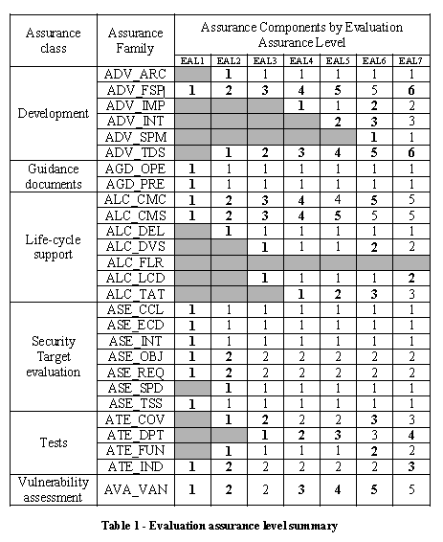
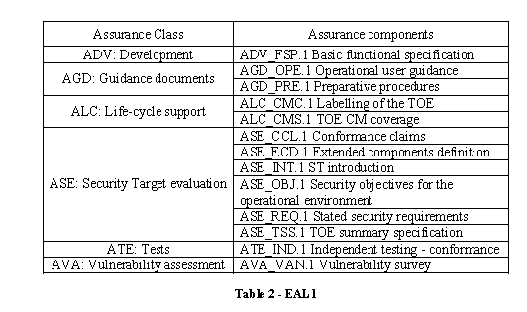
Common Criteria - EAL1
33
Notes:
CC is divided into levels from EAL 1 to 7, and it has been decided that the evaluation of the current project will be conducted based on EAL1.
The details of EAL1 are described in the table on the right.
CC는 EAL 1에서 7까지 레벨로 구분되며, 현 프로젝트의 평가는 EAL1을 기준으로 진행하는 것으로 결정하였습니다.
EAL1의 세부 내용은 오른쪽 테이블에 기술되어 있습니다.

Slide 35
Common Criteria - Result 1
We completed the review of the EAL1 items of the Common criteria as follows.
Anything not related to the project scope was treated as 'NA'.
Since the monitoring system had no intention of EAL1, we performed a light level of verification.
Assurance Class | Assurance Component | Evaluator Action Elements | Verdict
 |  |  | Evaluator Action Elements | Assurance Component | Assurance Class
ADV : Development | ADV_FSP.1 : Basic functional specification | ADV_FSP.1.1E | Pass | Pass | Pass
 |  | ADV_FSP.1.2E | Pass
AGD : Guidance documents | AGD_OPE.1 : Operation user guidance | AGD_OPE.1.1E | Pass | Pass | Pass
 | AGD_PRE.1 : Preparative procedures | AGD_PRE.1.1E | Pass | Pass
 |  | AGD_PRE.1.2E | Pass
ALC : Life-cycle support | ALC_CMC.1 : Labelling of the TOE | ALC_CMC.1.1E | Pass | Pass | Pass
 | ALC_CMS.1 : TOE CM coverage | ALC_CMS.1.1E | Pass | Pass
34
Notes:
The following table shows the evaluation results for EAL1 reference items.
The actual Team 4 project did not target EAL1, so it was evaluated by applying a simplified level.
다음의 표는 EAL1 기준 아이템에 대하여 평가를 수행한 결과를 보여줍니다.
실제 Team 4의 프로젝트는 EAL1을 타겟으로 하지 않았으므로, 이를 간소화한 레벨을 적용하여 평가하였습니다.

Slide 36
Common Criteria - Result 2
Area not covered
ASE: Security Target evaluation | ASE_CCL.1 : Conformance claims | ASE_CCL.1.1E | NA | NA | Pass
 | ASE_ECD.1 : Extended components definition | ASE_ECD.1.1E | NA | NA
 |  | ASE_ECD.1.2E | NA
 | ASE_INT.1 : ST introduction | ASE_INT.1.1E | Pass | Pass
 |  | ASE_INT.1.2E | Pass
 | ASE_OBJ.1 : Security objectives for the operational environment | ASE_OBJ.1.1E | Pass | Pass
 | ASE_REQ.1 : Stated security requirements | ASE_REQ.1.1E | Pass | Pass
 | ASE_TSS.1 : TOE summary specification | ASE_TSS.1.1E | Pass | Pass
 |  | ASE_TSS.1.2E | Pass
ATE : Tests | ATE_IND.1 : Independent testing - conformance | ATE_IND.1.1E | Pass | Pass | Pass
 |  | ATE_IND.1.2E | Pass
AVA : Vulnerability assessment | AVA_VAN.1 : Vulnerability survey | AVA_VAN.1.1E | Pass | Pass | Pass
 |  | AVA_VAN.1.2E | Pass
 |  | AVA_VAN.1.3E | Pass
35
Notes:
Except for some items that do not apply to the current project, it has been shown to pass for all items.
현재 프로젝트에 적용되지 않는 일부 항목을 제외하고, 모든 항목들에 대해 Pass함을 보여주었습니다.

Slide 37

Suggestions for better security products
We wish there were password guidelines when creating an account.
We wish it would like to add a verification function for the certificate.
We wish it would like to apply the Secure Coding guide additionally.
We wish that confirmation of user when registering user and confirmation of existing registration
We wish that a review of techniques to check for spoofing on fake faces
We wish Non-repudiation applied by creating a video file corresponding to the log file
We wish that limit number of attempts for ID/PASSWORD at login
We wish that apply patch for open source vulnerability
36
Notes:
After evaluating the project of the team 4, we have summarized the contents we would like to propose for better security.
We suggest guidelines for passwords, creation of video files for non-repudiation, and restrictions on login attempts.
4팀의 프로젝트를 평가한 뒤, 보다 향상된 보안을 위하여 제안하고자 하는 내용을 정리해 보았습니다.
패스워드의 가이드라인과 부인방지를 위한 비디오 파일의 생성, 로그인 시도에 대한 제한 등의 내용을 제안합니다.

Slide 38
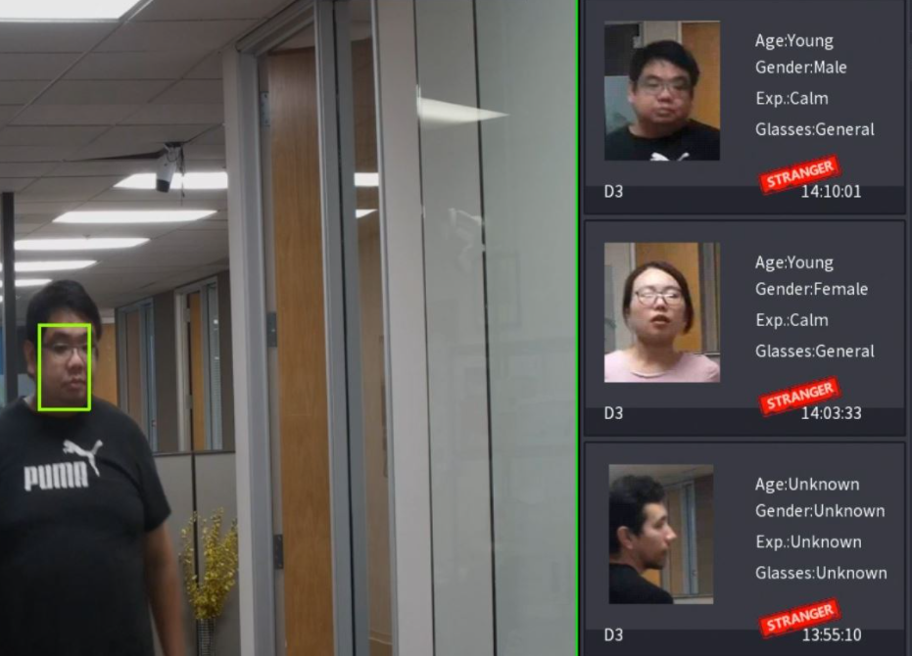
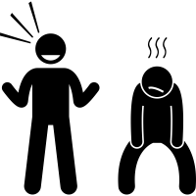
Strength & Weakness
Strength of Team 4
Weakness of Team 4
We reviewed various vulnerabilities for security, but it was confirmed that team 4's security was well prepared.
It would be convenient if a history management UI for strangers is provided as in the product below.
The Monitoring system has no UI, so the security agent must check the stranger only in real time.
Minimal interface design for security
- Monitoring system and CCTV operation
Simplified use through mutual authentication
Provides user register function for minimal privileges
Encryption applied to user image files
Apply OS key control (key ring)
Apply log for non-repudiation
Uni-direction network data flow
37
Notes:
This page summarizes the strengths and weaknesses of the team 4 project.
A weak point was that there were many restrictions on usability because a GUI was not provided.
However, the strengths were that the minimal interface was considered for security and the minimal privilege policy was applied for user registration.
4팀 프로젝트의 강점과 약점에 대해 정리한 페이지입니다.
GUI가 제공되지 않아 사용성에 많은 제한에 있는 부분이 약점이었습니다.
하지만 보안을 위하여 최소한의 인터페이스를 고려한 점과 사용자 등록을 위해 minimal privilege 정책을 적용한 부분이 강점이었습니다.

Slide 39
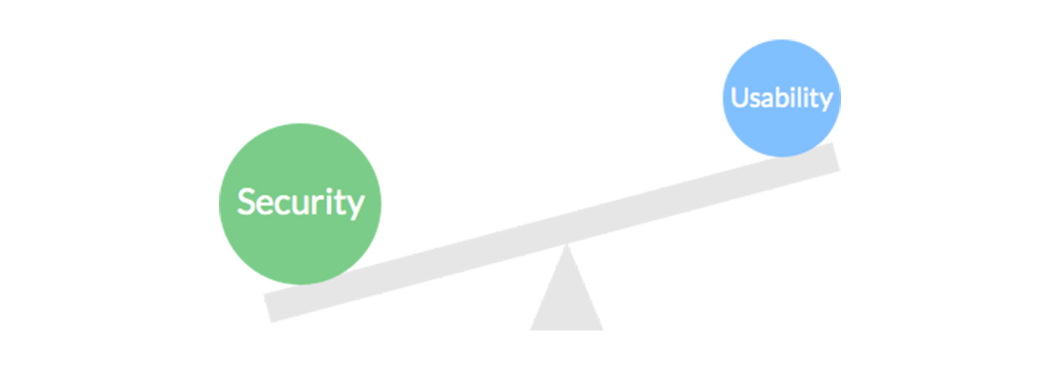
Conclusion
38
Notes:
Finally, it can be concluded that Team 4's project needs improvement in usability, but the implementation for security is well done.
마지막으로 Team 4의 프로젝트는 사용성 부분을 개선할 필요가 있으나 보안에 대한 구현은 잘 했다고 결론을 내릴 수 있었습니다.

Slide 40
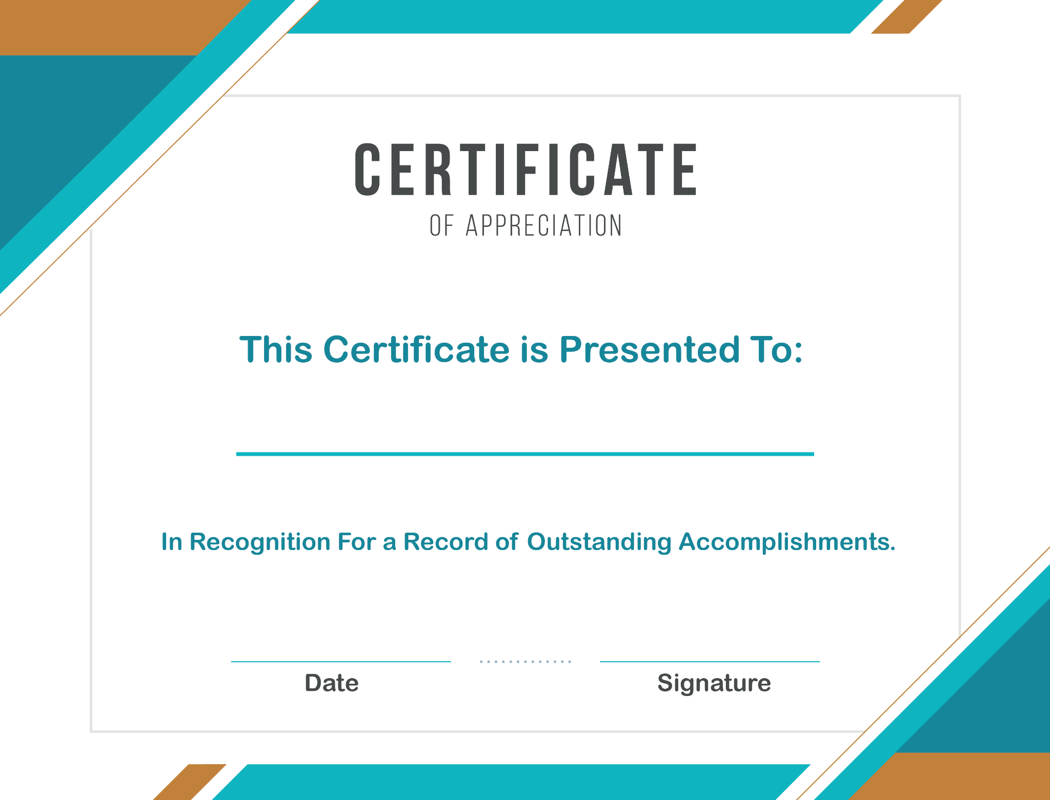
Security Cerificate
Team 4 : 4tential
2021.7.1
39
Notes:
Therefore, Team 3 issues a Certificate to Team 4 as a result of good security.
Congratulations.
따라서 Team 3에서는 우수한 보안에 대한 결과로 Team 4에 Certificate를 발급해 드립니다.
축하합니다.

Slide 41
Lesson & Learned
1. As we evaluate the work of other teams, it seems to be an opportunity to reconsider what we did.
2. In order to review security vulnerabilities,
I had the experience of analyzing the project from a new perspective.
3. Another team's vulnerability is our team's vulnerability . We've found that it takes a lot of effort to create a secure program.
4. I'm impressed that the sudo command has had the vulnerability for about 10 years.The work of other team was a result I thought was well written, so I thought it was perfect, but as we continued to review it with patience, we saw something to improve. I have come to realize that security assessments need to be constantly reviewed from all sides.
5. Analyzing vulnerabilities from an attacker’s point of view was a new experience, and I have found the importance of analyzing and removing threats by multiple perspectives.
6. It’s interesting to review other team’s security features. CMU githubs can be the security coding reference book for me! Thank you!
7. We must have in depth knowledge of at least one tool in each phase of evaluation, including its uses, internals, pro and cons.
40
Notes:
After progressing to phase 2, the team 3 members learned the following.
phase 2까지 진행 후 team 3 멤버들이 배운점은 다음과 같습니다.

Slide 42

41
Notes:
Here's what Team 3 has prepared for you.
Any questions?
Team 3에서 준비한 내용은 여기까지 입니다.
질문 있으세요?

